Slide 1
status
Run sensitivities / monte carlo
Run differential evolution to look for a solution that fits the measurements
Define disabling mechanisms and run with each of the mechanisms disabled
Total 74538 model runs
Visualize using umap, cluster using HDBSCAN

Slide 2
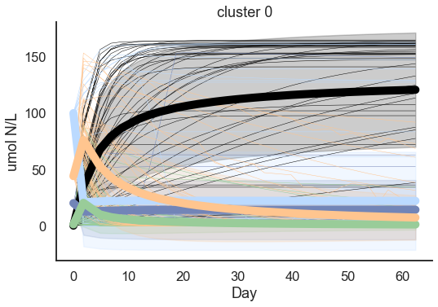
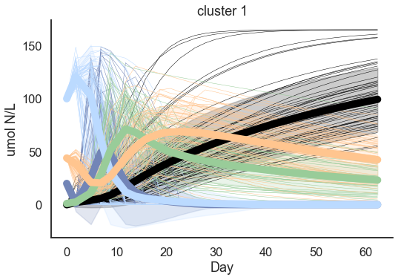
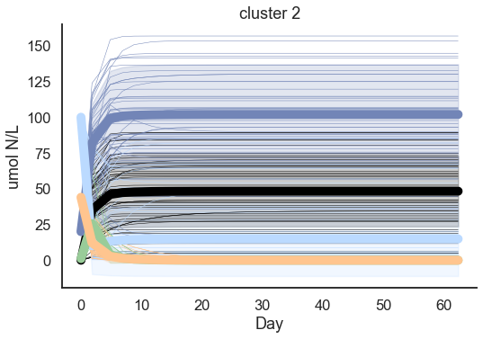
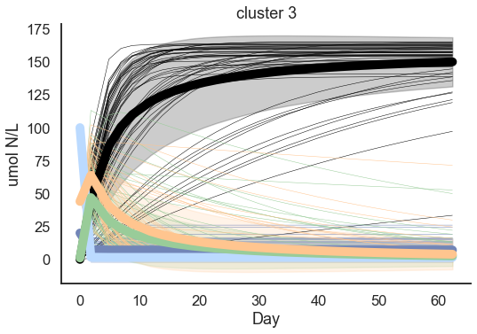
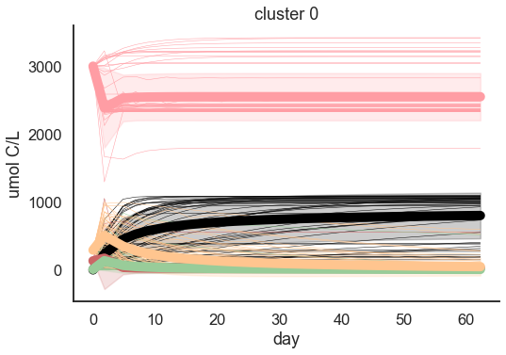
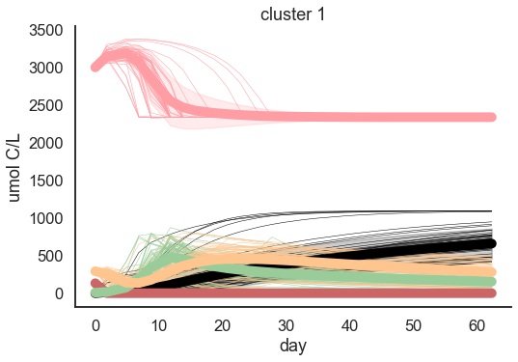
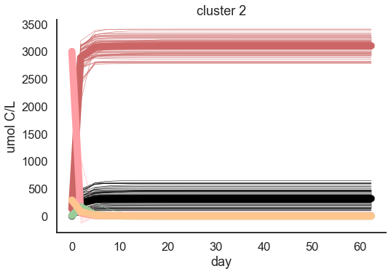
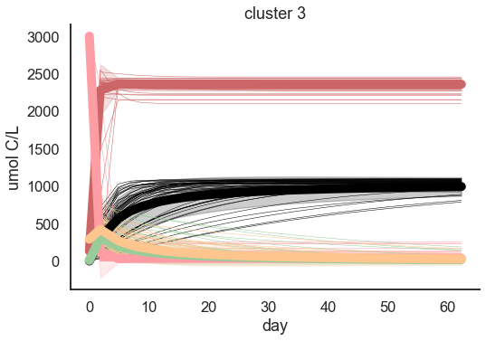
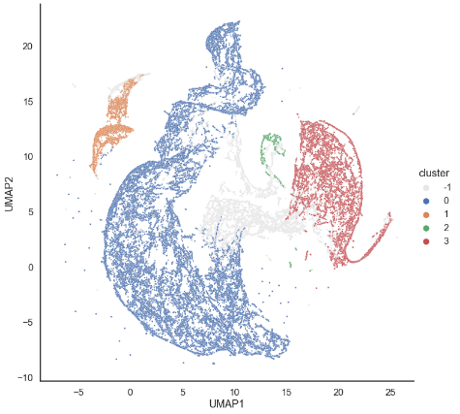
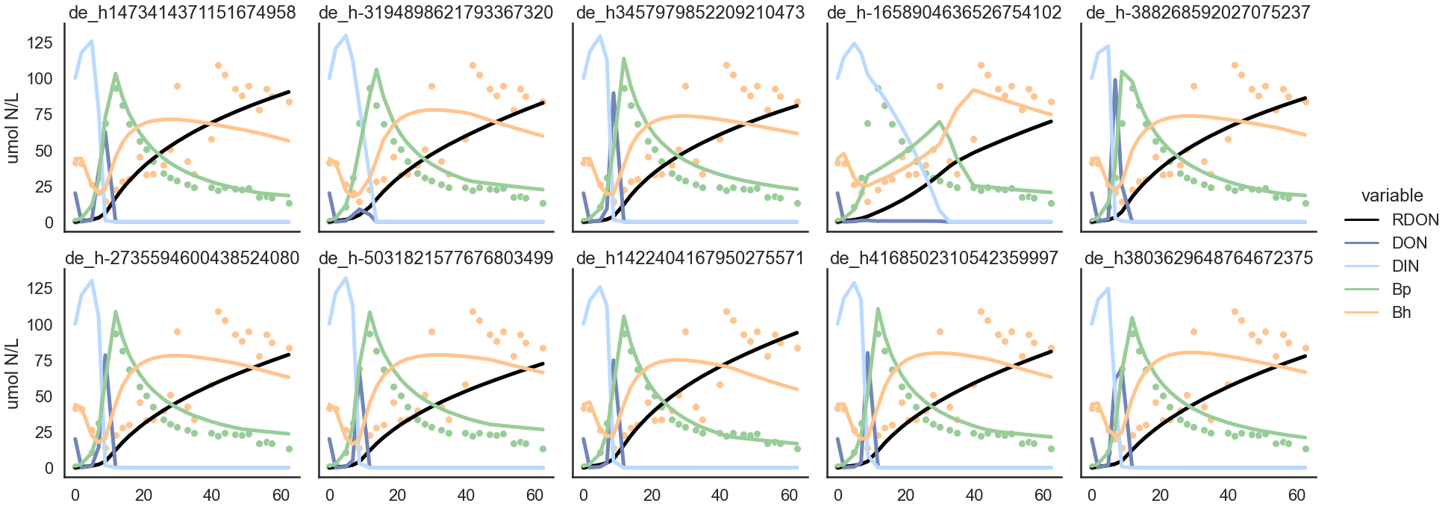
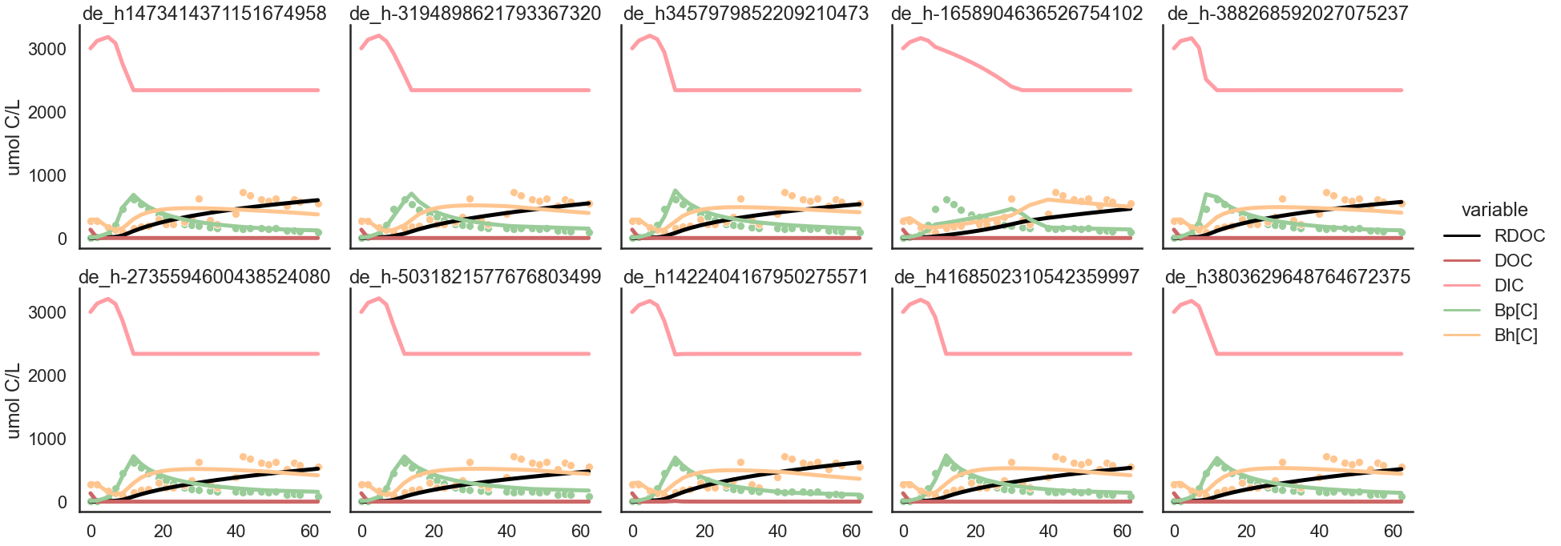
Cluster 0
N = 44301
Cluster 1
N = 4599
Cluster 2
N = 1426
Cluster 3
N = 12577
Not in any cluster
N = 11627

Slide 3
10 most similar to measurements

Slide 5
